Slide 1
Lectures 1 and 2

Slide 2
Coupled 2-box problem
(closed system, mass conserved).

Slide 3
1-box, impulse
1-box, with forcing
t/T*
2-box, impulse,
with 1st order decay

Slide 4
## R code for Markov chain representing the 2-box model
# (for reference)
k.h =0.01 # = transition freq = 1/”lifetime”
n1=100;n2=0 # number of particles, initial
N1=n1;N2=n2 # Nj accumulates solutions
for(i in 1:1000){
if(n1==0)dn1=0 else dn1=sum(runif(n1)<k.h)
if(n2==0)dn2=0 else dn2=sum(runif(n2)<k.h)
##runif: uniform distribution random numbers between (0,1)
n1= n1-dn1+dn2 ## new value in box 1
n2= n2-dn2+dn1 ## in box 2
N1=c(N1,n1)
N2=c(N2,n2)
}
Notes:
We have seen that the problem is symmetric wrt predictors and response; and several ways that stochastic effects enter our problem; Now let's solve a very basic problem, fitting a straight line (a model!!) to data, {x ; y} <=> predictor, response

Slide 5
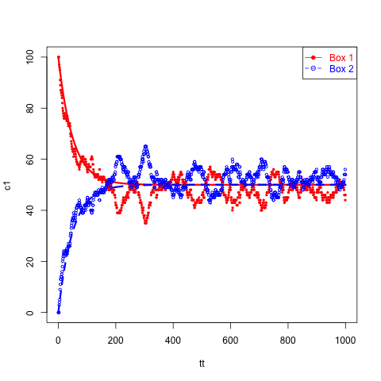
A working example: a 2-box model mass transfer model, and equivalent Markov chain
Markov chain representation of this model:
Box 1 -> Box 2 transition probability = k/h
Box 2 -> Box 1 transition probability = k/h
set k/h = 0.01 1% transition prob/time
proceed step-wise, stochastically (runif)
n1
(kg m⁻³)
h
(m)
k (m s⁻¹)
k (m s⁻¹)
h
(m)
n2
mass_{i} = h Area n_{i} ; set k/h=.01
h dn1/dt = k ( n2 –n1)
h dn2/dt = k ( n1 –n2)
(n1 – n2) = d = d_{o} exp(-2k/h t)
n1 + n2 = constant
ar(x = N1) Coefficients: 0.9761 Order selected 1 (corr time = -1/log(.9761)= 41.3 (exact=50))
Notes:
degrees of freeedom. run ar() on these data; the corr time exact = 50 (s), ar estimate 41 [ AR1^n= 1/e;
This is a Markov chain (probability to stay or leave; transition rate prop to number that are in each box =prior state
NOTE this noise is process noise, there will also be PDFs for every measurement (h, ni, etc)
An example of autorgressive behavior: capacity; NOTE Two ways to learn about the model--observe the transient or the steady state

Slide 6
Our working example: a 2-box model mass transfer model, and equivalent Markov chain
Model pdf parameter
Box 1 -> Box 2 transition probability = k/h
Box 2 -> Box 1 transition probability = k/h
n1
(kg m⁻³)
h
(m)
k (m s⁻¹)
k (m s⁻¹)
observations
h
(m)
n2
mass_{i} = h Area n_{i}
This result is one realization (or sample) of the Markov Chain
Example: turbulent exchange of trace gases
Notes:
An example of autorgressive behavior: capacity; Two ways to learn about the model--observe the transient or the steady state

Slide 7
2-box, stochastic, discrete
Concentration (# particles)
| T* →|
Time Step (#)
__
Defines: Relaxation time (T* = h/k), Variance ( σ = √ n /( 1 – r²) ) ;
r = exp(-k/hΔt) ≅ ( 1 – Δt *k/h)

Slide 8
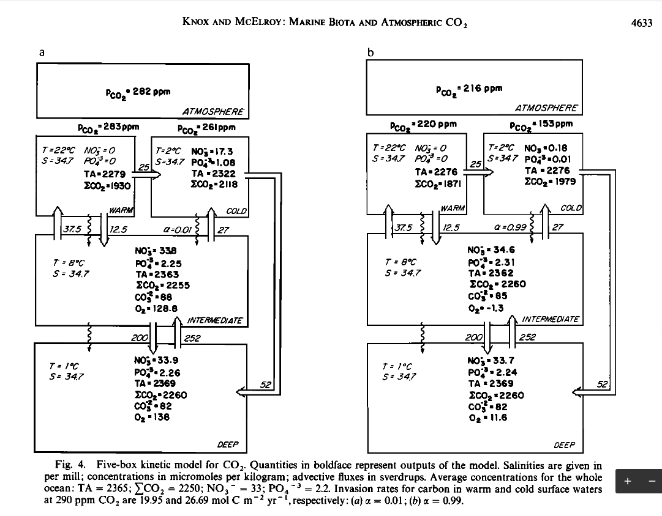
1
2
3
…
…
4
5
6
…

Slide 9
The time-dependence of any model composed of n reservoirs (boxes) and fluxes
between them given by linear functions of reservoir contents, can be written as
dx₁/dt = Σk_{1i}x_{i}
dx₂/dt = Σk_{2i}x_{i}
...
dx_{j}/dt = Σk_{ji}x_{i}
dx_{n}/dt = Σk_{ni}x_{i}
This is a familiar mathematical problem, a set of coupled, 1st-order, linear
differential equations that can be written in matrix form,
dX/dt = K*X,
where bold symbols denote matrices or vectors. For the initial value problem, where
X(t=0) = X₀, it is easy to show that the solution is given compactly as
X = exp(Kt) * X₀. (3.1)
Here is the demonstration: the function exp(Mt) of a matrix is defined in terms of a
power series analogous to exp(x), i.e.,
exp(M) = 1 + M + M²/2! + M³/3! + M⁴/4! + ....
If we differentiate exp(M) with respect to a scalar (say, t), we see that
d exp(M)/dt = exp(M) * d M/dt,
which proves the point for our case (M = K * t, K independent of t).

Slide 10
The system of coupled linear differential equations is solved efficiently using the eigenvalues and eigenvectors of the transport matrix.

